Slide 1
Anomaly Detection

Slide 2
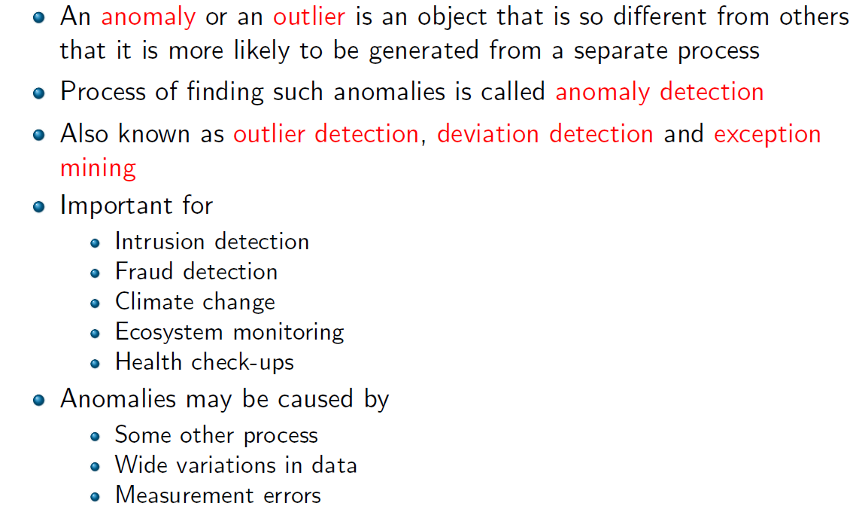
What is an anomaly?

Slide 3
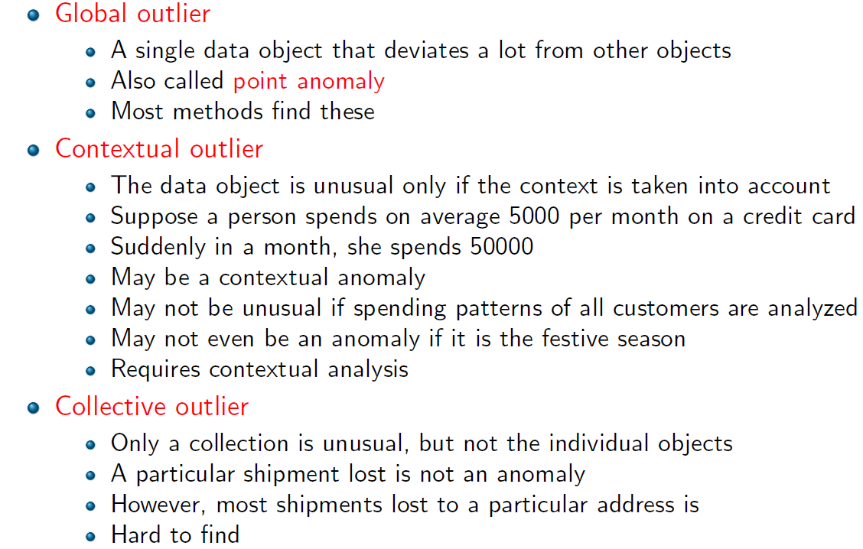
Types of anomalies

Slide 4

Statistical methods
Null Model
Object
$$<θ$$
P-value(Object)
Yes
How do you build this model?
Anomalous

Slide 5
P-value
P-value(v=o): Probability of observing a value as extreme as o
p(x>o)
Expected Value
Observed Value
Property

Slide 6
Sample problem
Suppose you want to track traffic flow in road segments. If the traffic is anomalous, then it could potentially be due to an accident, water logging, etc.
How would you do that?
Model traffic flow using a normal distribution. Compute the probability of the current flow.

Slide 7
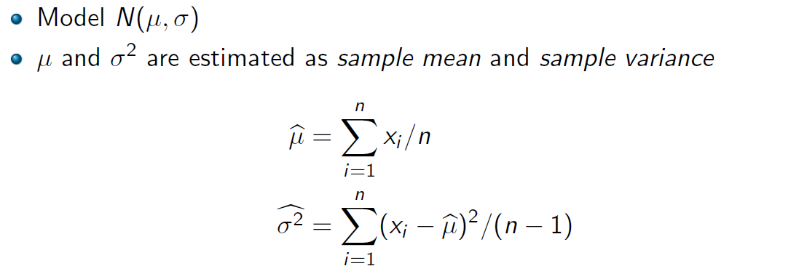

Univariate Normal distribution
Compute Z-score: How many std. dev away from mean?
Use the standard normal chart to compute p-values.
~66% within 1 std dev, 95% within 2 and 99% within 3.

Slide 8
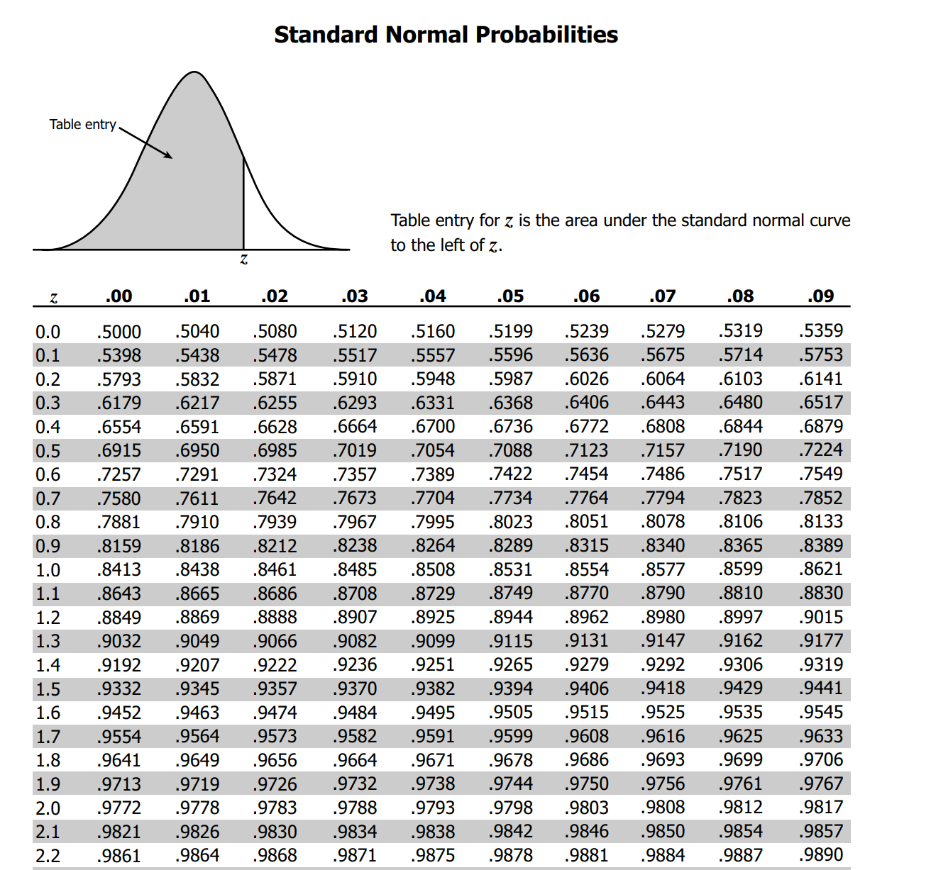

Slide 9
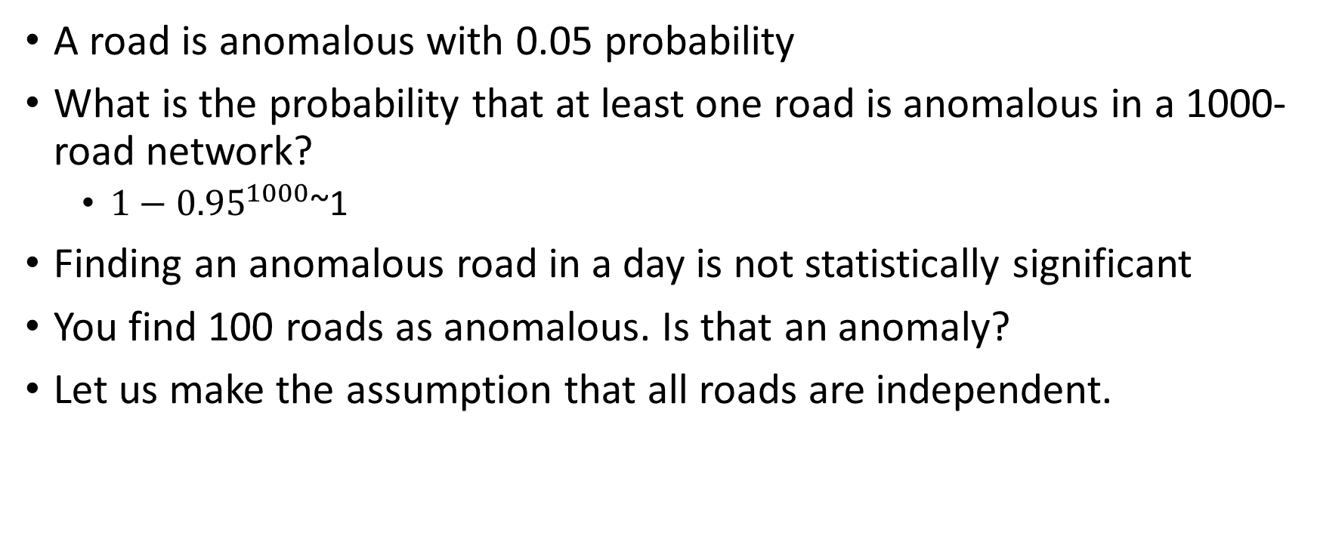
Anomalies at a global level
A road is anomalous with 0.05 probability
What is the probability that at least one road is anomalous in a 1000-road network?
$1−{0.95}^{1000}$~1
Finding an anomalous road in a day is not statistically significant
You find 100 roads as anomalous. Is that an anomaly?
Let us make the assumption that all roads are independent.

Slide 10
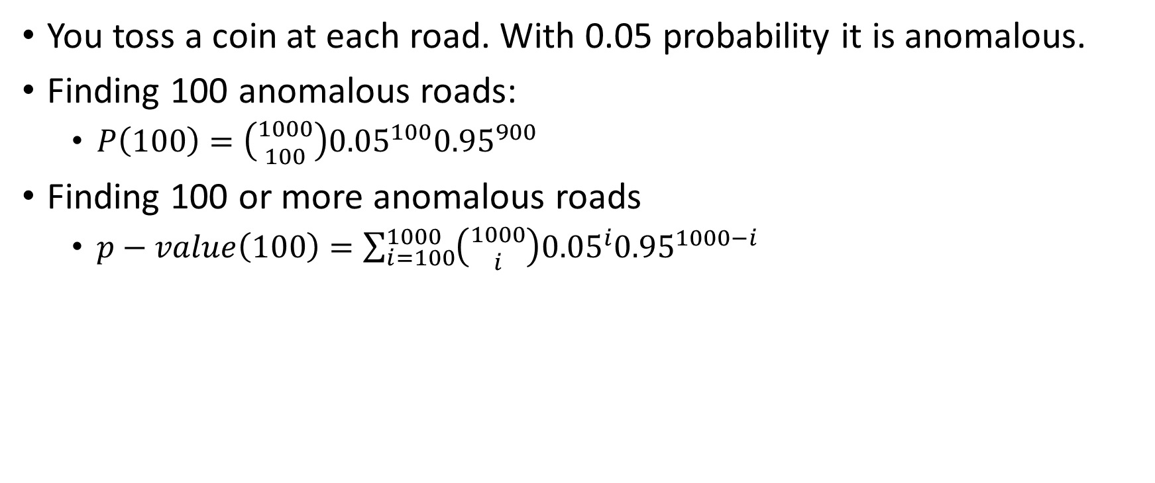
It’s like a coin toss…
You toss a coin at each road. With 0.05 probability it is anomalous.
Finding 100 anomalous roads:
$P\left(100\right)=\left({1000 \atop 100}\right){0.05}^{100}{0.95}^{900}$
Finding 100 or more anomalous roads
$p−value\left(100\right)=\sum_{i=100}^{1000}{\left({1000 \atop i}\right){0.05}^{i}{0.95}^{1000−i}}$

Slide 11
Moving to multiple categories
You are given 10 different road segments and their traffic category.
Clogged:7, Slow:2, Moving:1, Smooth:0
Each state happens with a certain probability
Clogged: 0.25
Slow: 0.4
Moving: 0.25
Smooth: 0.1
On the whole, is it anomalous?
P-value <0.05
How is it different from the single category setting?
Univariate to multivariate

Slide 12
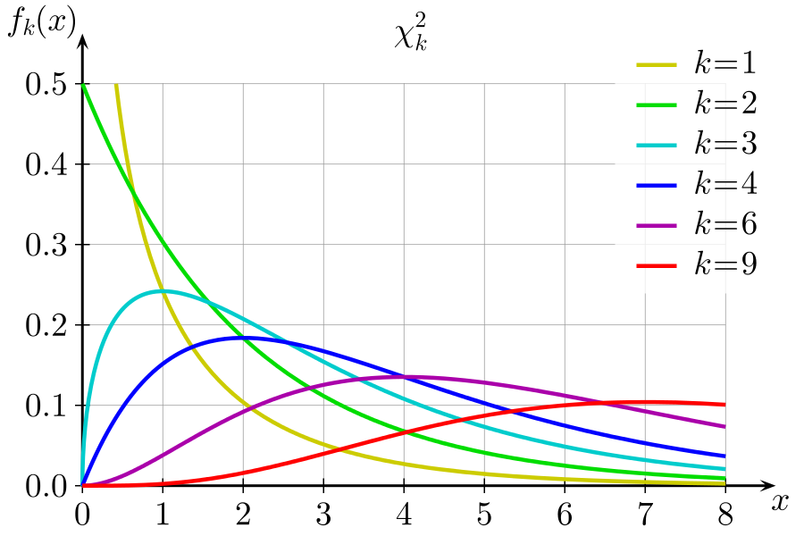
Use Chi-square test
Approximates Multinomial distributions
Chi-squared distribution
Distribution of a sum of the squares of k independent standard normal random variables
Normalized differences from the expected value in a multinomial (roughly) follow chi-square
Derivation: https://www.stat.berkeley.edu/~stark/SticiGui/Text/chiSquare.htm

Slide 13
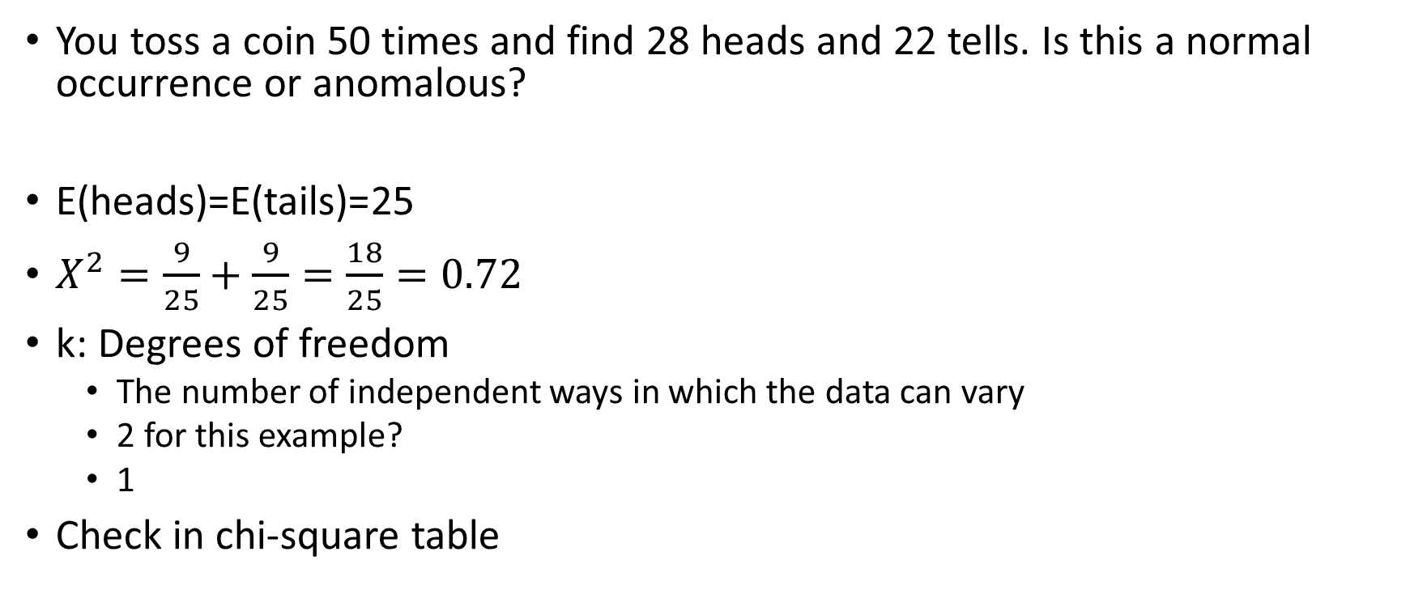
First the easy example
You toss a coin 50 times and find 28 heads and 22 tells. Is this a normal occurrence or anomalous?
E(heads)=E(tails)=25
$X^{2}=\frac{9}{25}+\frac{9}{25}=\frac{18}{25}=0.72$
k: Degrees of freedom
The number of independent ways in which the data can vary
2 for this example?
1
Check in chi-square table

Slide 14
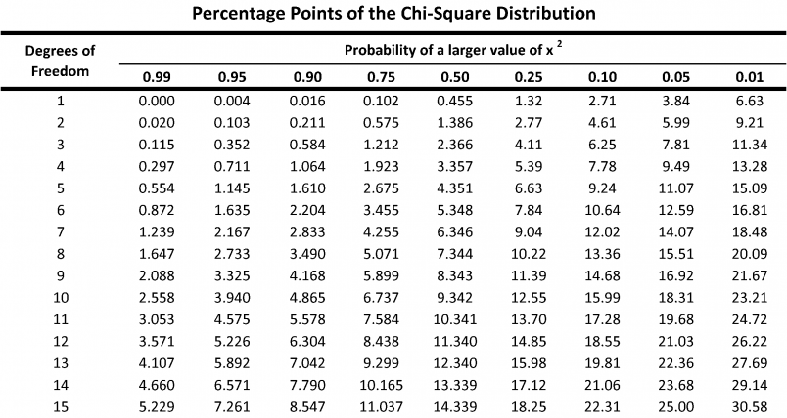
Get p-value..

Slide 15

Going back to our problem…
E(clogged)=2.5
E(slow)=4
E(normal)=2.5
E(smooth)=1
$x^{2}=\frac{{\left(7−2.5\right)}^{2}}{2.5}+\frac{{\left(4−2\right)}^{2}}{4}+\frac{{\left(1−2.5\right)}^{2}}{2.5}+\frac{1}{1}=11$
Anomalous

Slide 16
Things to check for Chi-square…
1. Observations must be independent
2. Problems arise when expected frequencies are very small. Chi-Square should not be used if more than 20% of the expected frequencies have a value of less than 5. (It does not matter what the observed frequencies are).
Two solutions: combine some categories (if this is meaningful in your experiment), OR obtain more data (make the sample size bigger).

Slide 17
Moving to multiple roads
You are given 10 different road segments, and their traffic speeds
Is it anomalous?
What’s different?
Don’t have categories

Slide 18
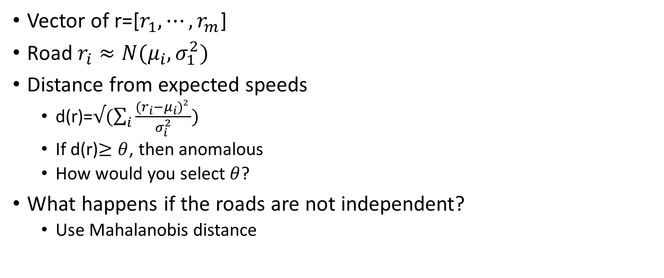
Multivariate normal distribution
Vector of r=[$r_{1},⋯,r_{m}$]
Road $r_{i}≈N(μ_{i},σ_{1}^{2})$
Distance from expected speeds
d(r)=$√(\sum_{i}{\frac{{(r}_{i}−μ_{i})2 }{σ_{i}^{2}}})$
If d(r)$≥θ$, then anomalous
How would you select $θ$?
What happens if the roads are not independent?
Use Mahalanobis distance

Slide 19
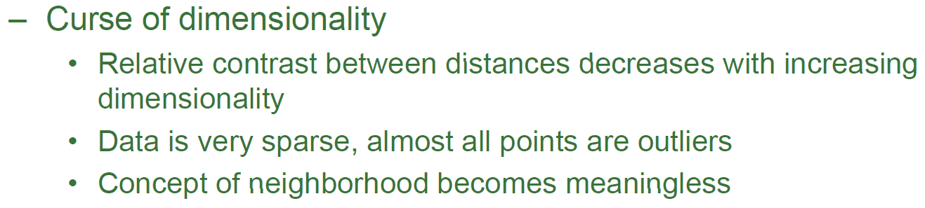
Anomaly detection in high dimensions
What is special about high dimensions?

Slide 20
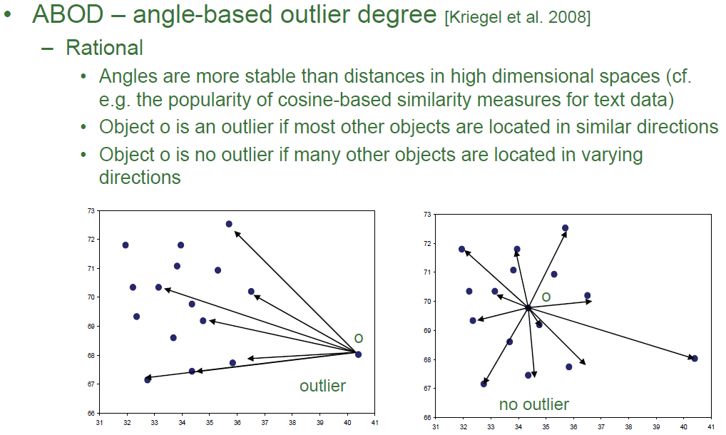
Measure Variance of angles
High: Not an outlier
Low: Outlier

